Slide 1
Mind-Reading Meets Language: A Graduation Project on BCI and NLP

Slide 2
Introduction
Background
Project Goals
Methodology
Expected Results
Conclusion

Slide 3
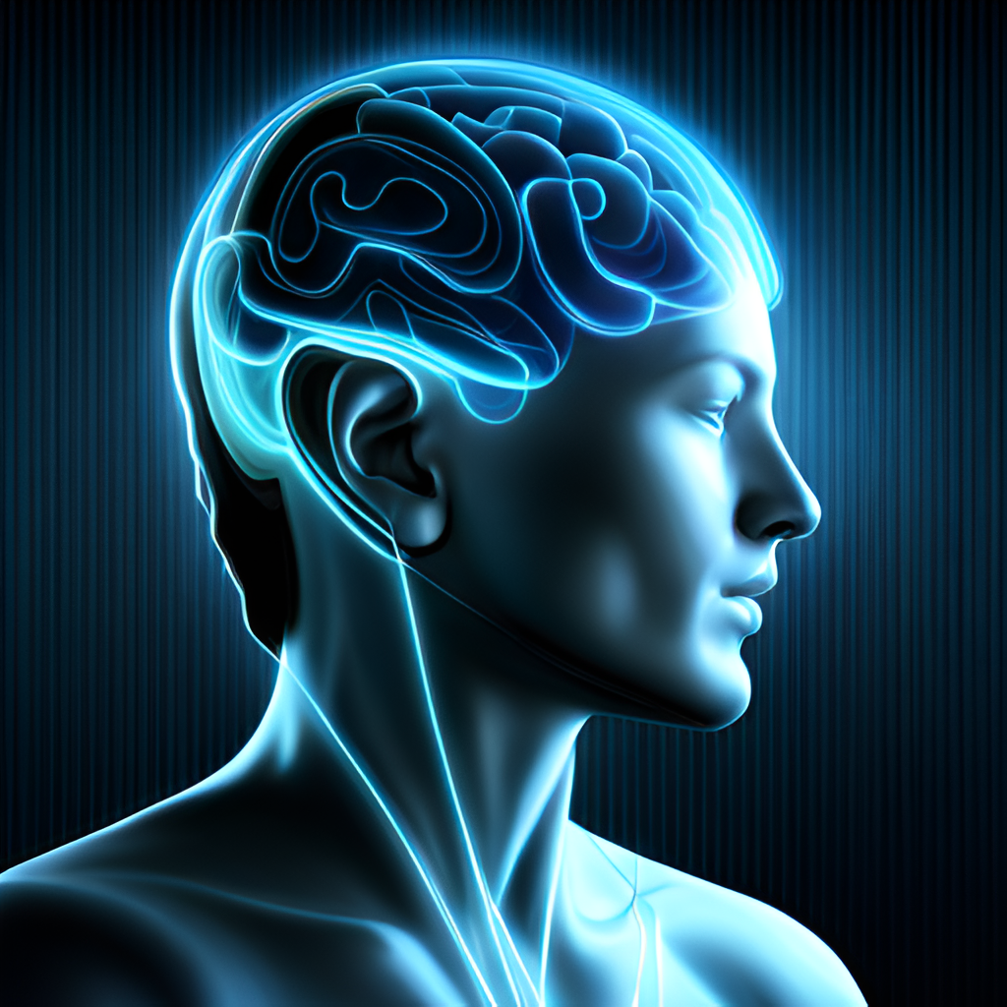
Introduction
Brain-Computer Interface (BCI) technology has been a topic of interest for many years, and with the advancements in Natural Language Processing (NLP), it has become even more promising. Our graduation project aims to explore the possibilities of combining BCI and NLP to create a system that allows users to communicate with computers using their thoughts.
The project involves designing and developing a prototype system that can accurately interpret brain signals and convert them into meaningful commands that are then executed by the computer. This system has the potential to revolutionize the way we interact with technology, especially for people with disabilities.

Slide 4

Background
BCI technology works by detecting and interpreting electrical signals generated by the brain. These signals are captured using sensors placed on the scalp or implanted directly into the brain. The signals are then processed and translated into commands that can be used to control external devices such as computers or prosthetic limbs.
NLP, on the other hand, is a subfield of artificial intelligence that focuses on the interaction between humans and computers using natural language. It involves analyzing and understanding human language to enable computers to respond appropriately. NLP has applications in various fields, including virtual assistants, chatbots, and speech recognition systems.

Slide 5

Project Goals
The primary goal of our project is to develop a BCI system that can accurately interpret brain signals and convert them into natural language commands. We aim to create a system that is easy to use and can be adapted to different users, including those with disabilities.
We also aim to explore the potential of this technology in various applications, such as virtual assistants, communication aids, and gaming. By demonstrating the capabilities of our prototype system, we hope to inspire further research and development in this field.

Slide 6
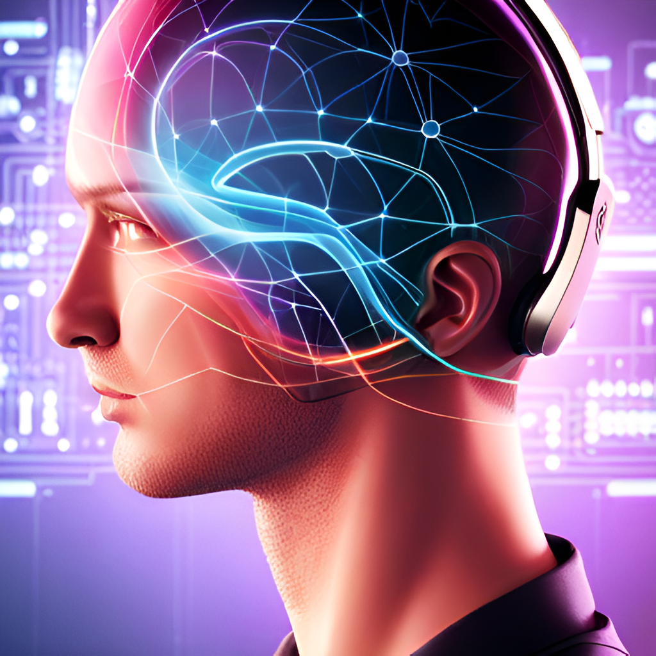
Methodology
To achieve our project goals, we will first conduct a literature review to gain an understanding of the current state of BCI and NLP technologies. We will then design and build a prototype BCI system using EEG (electroencephalography) sensors and machine learning algorithms to interpret brain signals.
We will test the system using a variety of tasks, such as controlling a virtual assistant or playing a game, to evaluate its accuracy and usability. We will also collect feedback from users to improve the system's performance and user experience.

Slide 7

Expected Results
We expect our prototype system to accurately interpret brain signals and convert them into natural language commands with a high degree of accuracy. We also expect the system to be adaptable to different users and tasks, making it suitable for a range of applications.
By demonstrating the feasibility and potential of this technology, we hope to inspire further research and development in this field. Ultimately, we believe that BCI with NLP has the potential to revolutionize the way we interact with technology and improve the lives of people with disabilities.

Slide 8

Conclusion
In conclusion, our graduation project aims to explore the possibilities of combining BCI and NLP technologies to create a system that allows users to communicate with computers using their thoughts. We believe that this technology has the potential to revolutionize the way we interact with technology and improve the lives of people with disabilities.
By designing and developing a prototype system, we hope to demonstrate the feasibility and potential of this technology and inspire further research and development in this field. We look forward to sharing our results and contributing to the advancement of BCI and NLP technologies.

